Slide 1
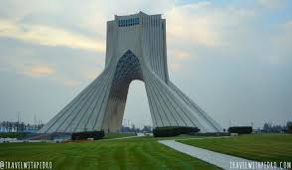
RC66 Announcements

Slide 2
Eco-friendly RC66 (paperless)
The organizers are committed to ensuring that this session of the Regional Committee will be more environmentally friendly than previous sessions through a paperless initiative.

Slide 3
Walk the Talk
It will also seek to encourage people’s participation in physical activity initiatives and ensuring healthier food options are available to delegates.

Slide 4
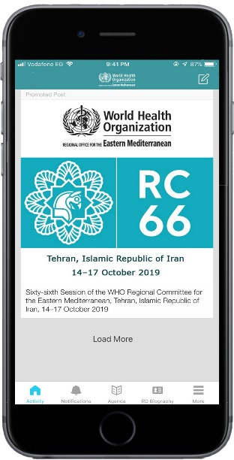
Access to RC66 documentation
WHO EMRC66 Mobile app
Download WHO Events app from App Store or Google Play.
Access to all documentation and material via WHO EMRC66 event as a one-stop-shop for everything.

Slide 5
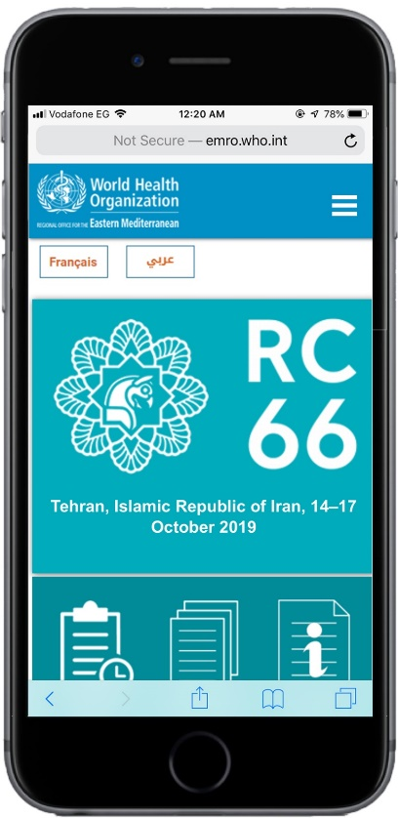
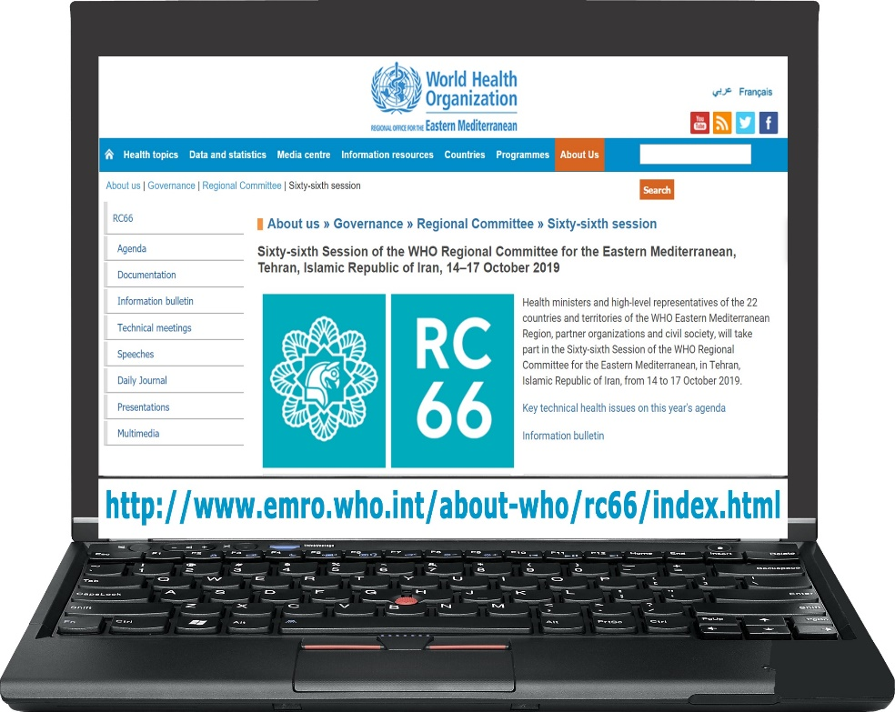
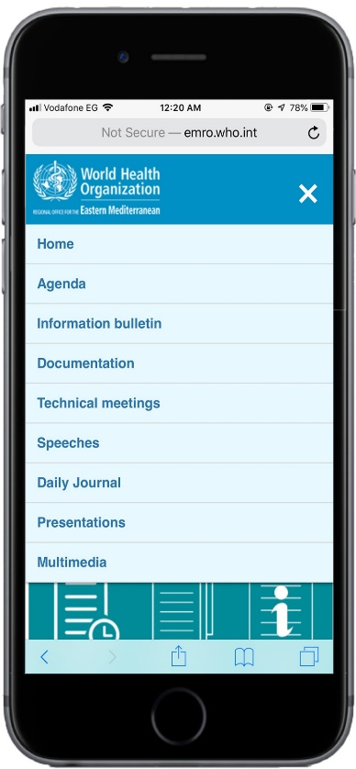
Access to RC66 documentation
Mobile friendly website
http://www.emro.who.int/about-who/rc66/index.html

Slide 6
Internet access
To access the internet connect to the WIF “*****” and enter the WIFI password *****
Or scan the QR code on the posters on the walls

Slide 7
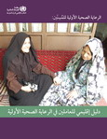
WHO ePublications stand
A hybrid display stand of the most recent publications.
Please visit the WHO ePublications stand to receive a flash memory stick containing more than 250 publications

Slide 8
RCC on social media
RC66 Photos | https://www.flickr.com/photos/149309436@N05/
 | https://www.facebook.com/WHOEMRO
 | https://twitter.com/WHOEMRO

Slide 9
Traffic lights
The traffic lights arrangements has always proved very successful with your support. The same arrangement will continue this year. Delegates’ interventions should be limited to three minutes focusing on the topic under discussion

Slide 10
Interpretation Services
The working languages of the Committee are Arabic ۞ English ۞ French
Speak clearly and at a moderate rate.
Interpreters need to view the speaker and presentation, please avoid standing in front of the interpretation booth.
Interventions can also be shared ahead with the interpreters through emrgorcrep@who.int, for better simultaneous translation.

